Slide 1
UAE Used Cars Analysis
Davis Vang , Jiaming Zhang , Natnael Berhanu
DATE
This project investigates the factors that influence used car prices in the UAE

Slide 2
Informational
Key Features Included:
Make & model
Manufacturing year
Price & mileage
Fuel type & transmission
Body type & engine size
Sale location
Objective: Analyze key factors that influence the resale price of used cars in the UAE.
Source: Kaggle dataset titled “UAE Used Cars Analysis” by Mohamed Saad
Size: ~10,000 used car listings across UAE
Cities Covered: Dubai, Abu Dhabi, Sharjah, and others

Slide 3
Main Research Questions:
How does mileage affect resale price?
Does transmission type (automatic vs. manual) impact value?
Which features (e.g., brand, body type, location) matter most?
Does the interaction between mileage and brand/body type change its impact?
Is the mileage-price relationship linear or curved?
Which subset of variables best predicts price?

Slide 4
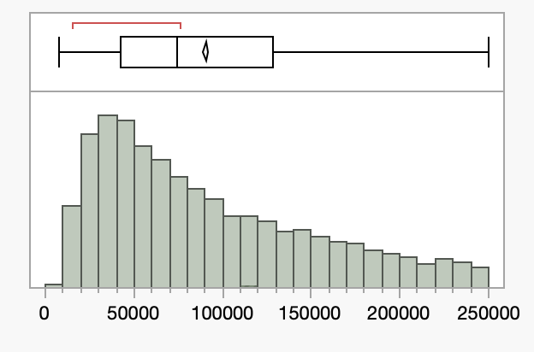
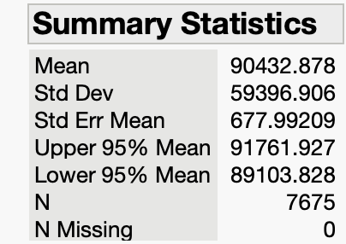
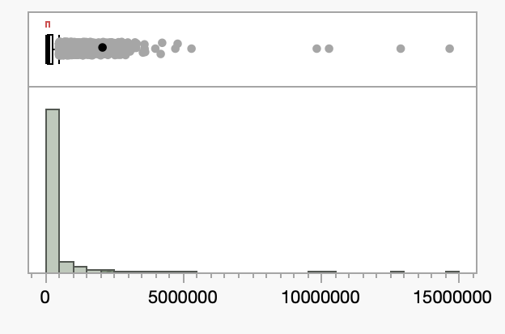
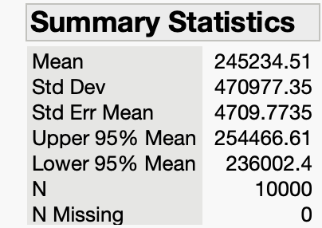
Why UAE?
DATE
Positives
Negatives
Market Relevance:
The UAE has a diverse, high-turnover car market with a mix of luxury and economy brands, making it ideal for studying price variation.
Not Universally Applicable:
UAE market trends may not reflect global or American car markets.

Slide 5

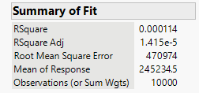
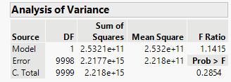


Model 1: Simple Linear Regression (Mileage Only)
Equation: E(y) = β₀ + β₁x₁
Hypothesis Test: H₀: β₁ = 0 vs Hₐ: β₁ ≠ 0
Model Summary:
R² = 0.0001, Adjusted R² = 0.00001
F Ratio = 1.1415, p-value = 0.2854
Mileage coefficient = 0.0601, p = 0.2854
Durbin-Watson = 1.98 (no autocorrelation)
RMSE = 470,974
This model tested if mileage could predict car prices, but the results weren’t strong. The p-value was 0.2854, so mileage isn’t a significant factor on its own. The R² was basically zero (0.0001), which means the model doesn’t explain much at all.
Even though the residuals looked okay (Durbin-Watson ≈ 2), the model had a huge error (RMSE = 470,974).
Overall: Mileage by itself doesn’t tell us much about car prices. We need more variables like brand, body type, or year to build a better model.

Slide 6
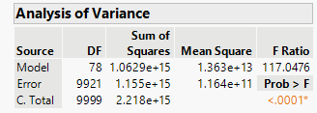
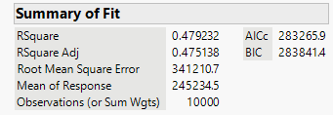
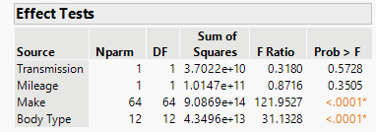
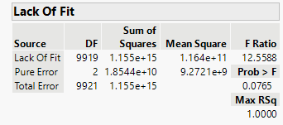
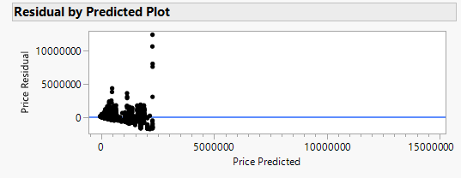

Model 2
Equation: E(y) = β₀ + β₁x₁ + β₂x₂ + ... + β₇₈x₇₈
Hypothesis Test: H₀: All β's = 0 vs Hₐ: At least one β ≠ 0
Model Summary:
R² = 0.4792, Adjusted R² = 0.4751
F Ratio = 117.05, p-value < 0.0001
Mileage p = 0.3505
Transmission p = 0.5728
Durbin-Watson = 1.998 (no autocorrelation)
RMSE = 341,210.7
This model tested whether features like brand, body type, mileage, and transmission can predict car prices. The p-value is very small (< 0.0001), which means the model is statistically strong. The R² is 0.48, so it explains 48% of the variation in prices a big improvement from before.
Mileage and transmission don’t seem helpful alone (both have high p-values), but brand and body type are very important (p < 0.0001). Brands like Ferrari or Rolls-Royce and body types like SUVs or sedans really affect price.
Even though the residuals had a bit of spread, the Durbin-Watson value near 2 means no autocorrelation. The error (RMSE) was also much lower than Model 1.

Slide 7
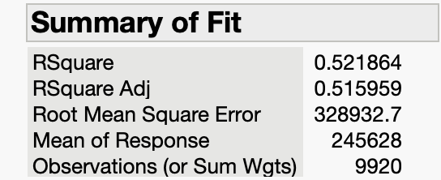
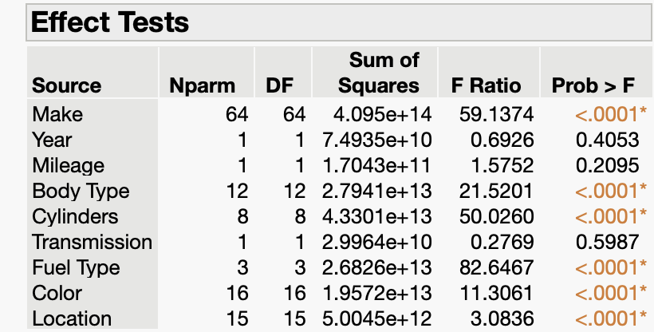
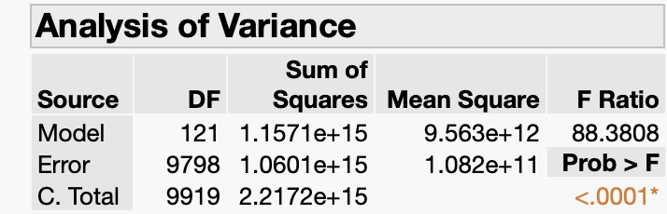
Model 3
What are the most important predictors of car price?
Model Performance
R² = 0.52 → Explains 52% of the variance in used car prices.
P-value < 0.0001 → At least one variable is significantly associated with price.
Make – Brand influences perceived value and reliability.
Body Type – Sedans, SUVs, trucks, etc. have different market values.
Cylinders – Engine size affects performance and price.
Fuel Type – Gas, diesel, hybrid, or electric influence demand and cost.
Color – Aesthetic preferences and resale value factors.
Location – Regional demand and supply impact pricing.

Slide 8
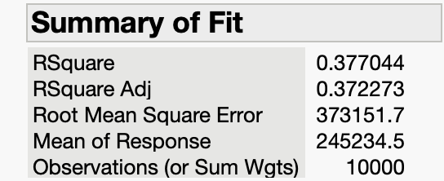
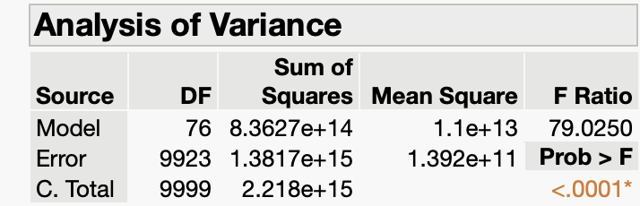
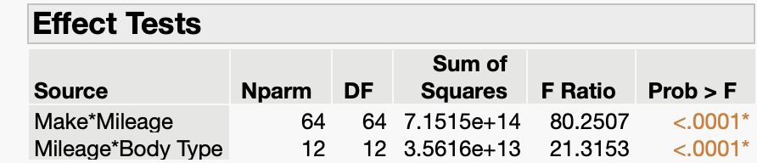
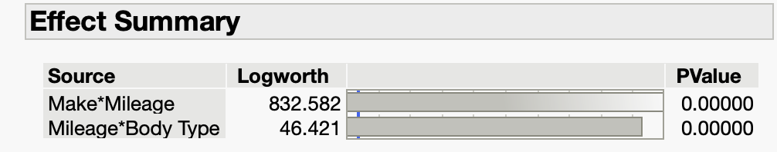
Model 4
This model we decided to look more into the effect of mileage differences across car types or brands.
Model Performance
R² = 0.37 → Explains 37% of the variance in used car prices.
Low P-values → Predictors are statistically significant.
Higher F-ratio for Make → Make has the strongest influence, even when mileage is the same.

Slide 9
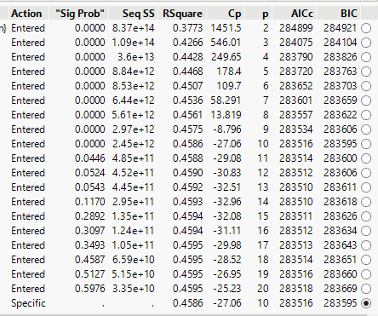
Model 5
Stepwise model with 3 progression
Choose Year, Mileage, Make and Location.
RSquare of 0.3773( 37.73% variance explained) with 2 parameters. It reaches a peak RSquare of 0.4629 with 26 parameters
RSquare : 0.4586
Cp: -27.06 (Minimum in this range)
AICc: 283516
BIC: 283595 ( Lowest BIC value)
A simpler model (10 predictors) may be preferable unless a slight RSquare boost justifies complexity.

Slide 10
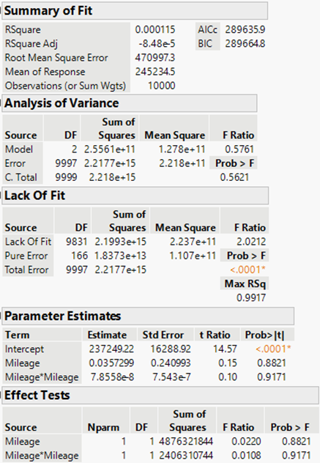
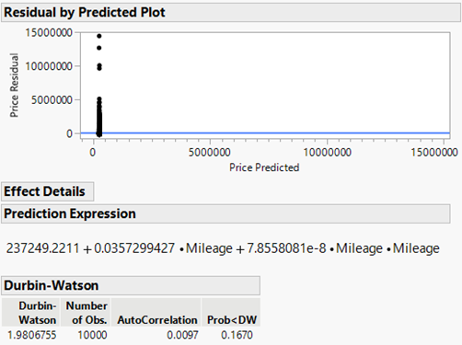
Model 6
Non-linear model, added a squared mileage term (Mileage²) to capture possible non-linear trends
R² = 0.000115
Adjusted R² = –0.0000848
F Ratio = 0.5761
Mileage p-value = 0.8821
Mileage² p-value = 0.9171
Durbin-Watson = 1.98 (no autocorrelation)
RMSE = 470,997 AED

Slide 11
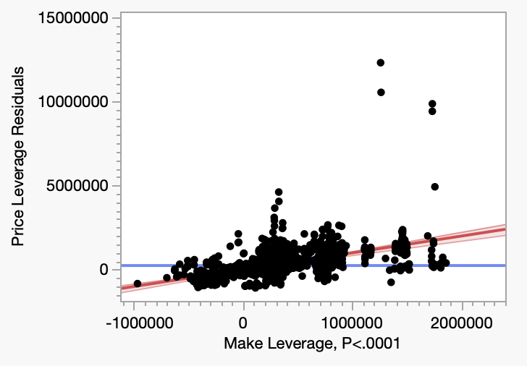
Conclusion
Initial Finding:
Mileage alone explains almost none of the variation in used car prices.
Model Improvements:
Adding variables like make, transmission, body type, location, and year greatly improved model performance.
Final Insight:
Make and Location are the most critical predictors of used car prices in the UAE
The plot illustrates how (Make) influences price residuals and the differences between predicted and actual prices.

Slide 12
Final Thoughts
Price ranges in the UAE are significantly higher than in typical U.S. markets, due to the presence of more luxury and exotic vehicles.
However, the core pricing patterns such as the strong influence of make, location, and vehicle type can still apply to other countries.
This analysis highlights how regression modeling can reveal the most important price drivers in any market, and could be adapted to U.S. data for further comparison.

